Slide 1
Course Schedule

Slide 2
If more than 52 students offer feedback to Dr. Qin on Canvas, then we will vote for one of the two options below.
Option 1: Open book and notes or
Option2: Release 30% questions before exams

Slide 3
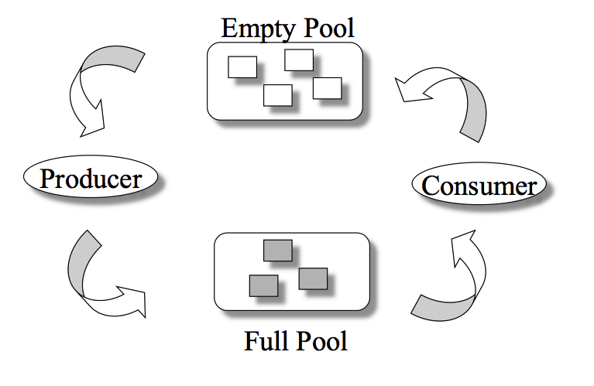
The Bounded-Buffer Problem
Exercise 2.3 (Plickers):
What is the initial value of empty (empty _bucket)?
-1
0
1
n
Notes:
2018 Fall. From Lecture 12 Slides 18-26.
Semaphore mutex: initial value 1
Semaphore full (full_bucket): initial value 0
Semaphore empty (empty_bucket) initial value n
Classical Problems of Synchronization
Classical problems used to test newly-proposed synchronization schemes
Bounded-Buffer Problem
Readers and Writers Problem
Dining-Philosophers Problem
Semaphore mutex initialized to the value 1
Semaphore full initialized to the value 0
Semaphore empty initialized to the value n

Slide 4
The Producer Process
Exercise 3: Where to place the mutex semaphore?
do {
... /* produce an item in next_produced */
...
wait(empty);
wait(mutex);
... /* add next produced to the buffer */
...
signal(mutex);
signal(full);
} while (true);

Slide 5
Exercise 4: Can you design a consumer process?
Do {
wait(full);
wait(mutex);
... /* remove an item from buffer to
next_consumed */
...
signal(mutex);
signal(empty);
... /* consume the item in next consumed */
... } while (true);

Slide 6
Summary
Semaphore
The Bounded-Buffer Problem
Next Lecture:
The Readers-Writers Problem
The Dining-Philosophers Problem
Introduction to Monitors
Notes:
Summary of Chapter 5.

Slide 7

Project 2 Feedback
What’s Good?
Good scripts
Report problems
What’s Bad?
Coding Questions: No. 4, 8 and 18
Notes:
This is the feedback for class Fall’17

Slide 8
Monitors
A high-level abstraction for process synchronization
Abstract data type: internal variables only accessible by code within the procedure
Only one process may be active within the monitor at a time
But not powerful enough to model some synchronization schemes
monitor monitor-name
{
// shared variable declarations
procedure P1 (…) { …. }
procedure Pn (…) {……}
Initialization code (…) { … }
}
Notes:
Homework 1 related.
A high-level abstraction that provides a convenient and effective mechanism for process synchronization
Abstract data type, internal variables only accessible by code within the procedure
Only one process may be active within the monitor at a time
But not powerful enough to model some synchronization schemes

Slide 9
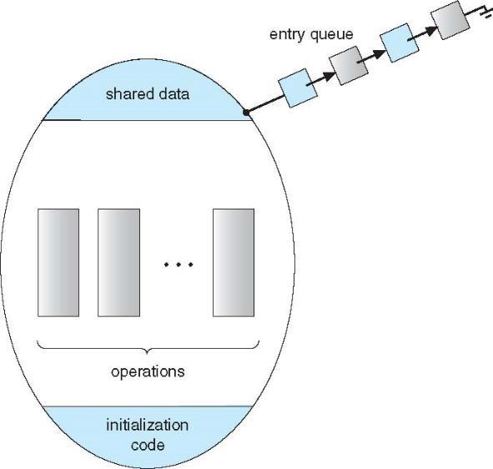
A Monitor

Slide 10
COMP 3500 Introduction to Operating Systems Synchronization: Part 4 (cont.) Classical Synchronization Problems
Dr. Xiao Qin
Auburn University http://www.eng.auburn.edu/~xqin
xqin@auburn.edu
Notes:
Spring’17:
Slides 1-5: 25 Minutes
Slides 6-13: 25 Minutes

Slide 11
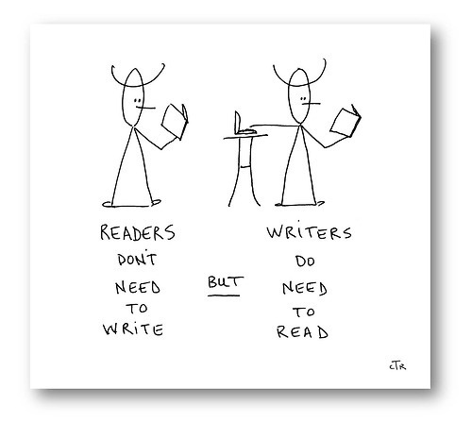
The Readers-Writers Problem
Concurrent processes
Readers – only read data; do not perform updates
Writers – both read and write
Problem:
Allow multiple readers to read at the same time
Only one single writer can access the shared data
Exercise 5: What semaphores do we need?
Semaphore rw_mutex initialized to 1
Semaphore mutex initialized to 1
Integer read_count initialized to 0
Notes:
A data set is shared among a number of concurrent processes
Readers – only read the data set; they do not perform any updates
Writers – can both read and write
Problem – allow multiple readers to read at the same time
Only one single writer can access the shared data at the same time
Several variations of how readers and writers are considered – all involve some form of priorities
Shared Data
Data set
Semaphore rw_mutex initialized to 1
Semaphore mutex initialized to 1
Integer read_count initialized to 0

Slide 12
The Writer Process Exercise 6: Which semaphore should we use here?
Question: Is it a semaphore or lock?
do { wait(rw_mutex);
... /* writing is performed */
...
signal(rw_mutex);
} while (true);
Only one single writer can access the shared data

Slide 13
The Reader Process Exercise 7: Can you explain the following process?
do { wait(mutex); read_count++; if (read_count == 1)
wait(rw_mutex);
signal(mutex);
... /* reading is performed */
...
wait(mutex); read count--; if (read_count == 0)
signal(rw_mutex);
signal(mutex);
} while (true);
A writer is in the critical section, n readers are waiting. Then …
n-1 wait here
1st waits here
Critical section?
Let a writer access
Multiple readers can access the shared data

Slide 14
Other Readers-Writers Problems
Problem 1: no reader kept waiting unless writer has permission to use shared object
Problem 2: once writer is ready, it performs the write ASAP
Both may have starvation
Notes:
Problem is solved on some systems by kernel providing reader-writer locks

Slide 15
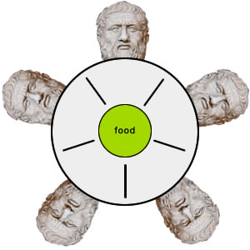
Exercise 1: Can you solve the dining-philosopher problem?
Exercise 1.1 (Plickers): What are the initial values of semaphore array chopstick[5]?
chopstick[0]= … chopstick[4] = 0;
chopstick[0]= … chopstick[3] = 1; chopstick[4]= 0;
chopstick[0]= … chopstick[3] = 0; chopstick[4]= 1;
chopstick[0]= … chopstick[4] = 1;
Philosophers spend their lives thinking and eating
Occasionally try to pick up 2 chopsticks (one at a time) to eat from bowl
In the case of 5 philosophers: Shared data
Bowl of rice
Semaphore chopstick [5]
Notes:
Philosophers spend their lives alternating thinking and eating
Don’t interact with their neighbors, occasionally try to pick up 2 chopsticks (one at a time) to eat from bowl
Need both to eat, then release both when done
In the case of 5 philosophers
Shared data
Bowl of rice (data set)
Semaphore chopstick [5] initialized to 1

Slide 16
The structure of Philosopher i
/* After */
do {
wait (chopStick[ (i + 1) % 5] );
wait (chopstick[i] );
// eat
signal (chopstick[ (i + 1) % 5] );
signal (chopstick[i] );
// think
} while (TRUE);
/* Before */
do {
wait (chopstick[i] );
wait (chopStick[ (i + 1) % 5] );
// eat
signal (chopstick[i] );
signal (chopstick[ (i + 1) % 5] );
// think
} while (TRUE);
Exercise 1.2 (Plickers): Can you switch the order of the two chopsticks?
No
Yes
Sometimes
Depends

Slide 17
Exercise 2: What is the problem with this algorithm?
do {
wait (chopstick[i] );
wait (chopStick[ (i + 1) % 5] );
// eat
signal (chopstick[i] );
signal (chopstick[ (i + 1) % 5] );
// think
} while (TRUE);

Slide 18
Deadlock Handling
Allow at most 4 philosophers to be sitting simultaneously at the table.
Allow a philosopher to pick up the forks only if both are available (picking must be done in a critical section.
Use an asymmetric solution -- an odd-numbered philosopher picks up first the left chopstick and then the right chopstick. Even-numbered philosopher picks up first the right chopstick and then the left chopstick.

Slide 19
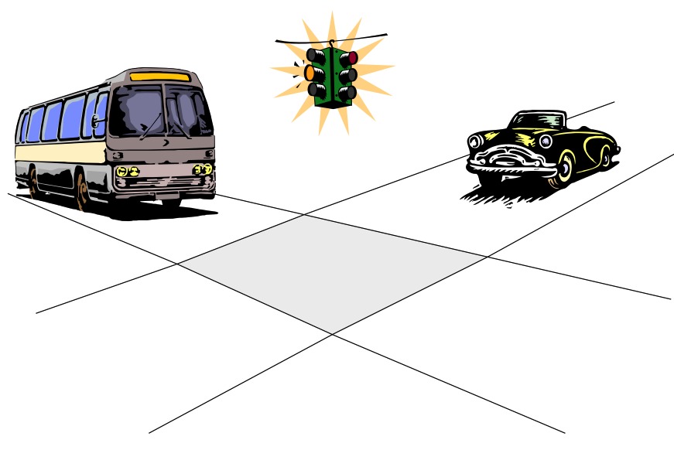
Problems with Semaphores
Incorrect use of semaphore operations:
signal (mutex) …. wait (mutex)
wait (mutex) … wait (mutex)
Omitting of wait (mutex) or signal (mutex) (or both)
Deadlock and starvation are possible.
Notes:
Inverse order: signal(mutex) wait(mutex)
Repeate calls: wait, wait
Omitted calls.

Slide 20
Pthreads
Notes:
Reference: https://en.wikipedia.org/wiki/POSIX_Threads
POSIX Threads, usually referred to as Pthreads, is an execution model that exists independently from a language, as well as a parallel execution model. It allows a program to control multiple different flows of work that overlap in time. Each flow of work is referred to as a thread, and creation and control over these flows is achieved by making calls to the POSIX Threads API. POSIX Threads is an API defined by the standard POSIX.1c, Threads extensions (IEEE Std 1003.1c-1995).
Implementations of the API are available on many Unix-like POSIX-conformant operating systems such as FreeBSD, NetBSD,OpenBSD, Linux, Mac OS X and Solaris, typically bundled as a library libpthread. DR-DOS and Microsoft Windows implementations also exist: within the SFU/SUA subsystem which provides a native implementation of a number of POSIX APIs, and also within third-party packages such as pthreads-w32,^{[1]} which implements pthreads on top of existing Windows API.
pthread.h

Slide 21
Summary
The Readers-Writers Problem
The Dining-Philosophers Problem
What’s next: Introduction to Monitors
Notes:
Summary of Chapter 5.

Slide 22
Notes:
On success, pthread_create() returns 0; on error, it returns an error number, and the contents of *thread are undefined.

Slide 23
Implementing Semaphores Using Pthreads Exercise 3: What is the value item in the following structure? Why we need a lock?
Notes:
Reference: https://en.wikipedia.org/wiki/POSIX_Threads
POSIX Threads, usually referred to as Pthreads, is an execution model that exists independently from a language, as well as a parallel execution model. It allows a program to control multiple different flows of work that overlap in time. Each flow of work is referred to as a thread, and creation and control over these flows is achieved by making calls to the POSIX Threads API. POSIX Threads is an API defined by the standard POSIX.1c, Threads extensions (IEEE Std 1003.1c-1995).
Implementations of the API are available on many Unix-like POSIX-conformant operating systems such as FreeBSD, NetBSD,OpenBSD, Linux, Mac OS X and Solaris, typically bundled as a library libpthread. DR-DOS and Microsoft Windows implementations also exist: within the SFU/SUA subsystem which provides a native implementation of a number of POSIX APIs, and also within third-party packages such as pthreads-w32,^{[1]} which implements pthreads on top of existing Windows API.

Slide 24
Implementing wait()
Notes:
Reference: https://en.wikipedia.org/wiki/POSIX_Threads
POSIX Threads, usually referred to as Pthreads, is an execution model that exists independently from a language, as well as a parallel execution model. It allows a program to control multiple different flows of work that overlap in time. Each flow of work is referred to as a thread, and creation and control over these flows is achieved by making calls to the POSIX Threads API. POSIX Threads is an API defined by the standard POSIX.1c, Threads extensions (IEEE Std 1003.1c-1995).
Implementations of the API are available on many Unix-like POSIX-conformant operating systems such as FreeBSD, NetBSD,OpenBSD, Linux, Mac OS X and Solaris, typically bundled as a library libpthread. DR-DOS and Microsoft Windows implementations also exist: within the SFU/SUA subsystem which provides a native implementation of a number of POSIX APIs, and also within third-party packages such as pthreads-w32,^{[1]} which implements pthreads on top of existing Windows API.

Slide 25
Implementing signal()
Notes:
Reference: https://en.wikipedia.org/wiki/POSIX_Threads
POSIX Threads, usually referred to as Pthreads, is an execution model that exists independently from a language, as well as a parallel execution model. It allows a program to control multiple different flows of work that overlap in time. Each flow of work is referred to as a thread, and creation and control over these flows is achieved by making calls to the POSIX Threads API. POSIX Threads is an API defined by the standard POSIX.1c, Threads extensions (IEEE Std 1003.1c-1995).
Implementations of the API are available on many Unix-like POSIX-conformant operating systems such as FreeBSD, NetBSD,OpenBSD, Linux, Mac OS X and Solaris, typically bundled as a library libpthread. DR-DOS and Microsoft Windows implementations also exist: within the SFU/SUA subsystem which provides a native implementation of a number of POSIX APIs, and also within third-party packages such as pthreads-w32,^{[1]} which implements pthreads on top of existing Windows API.

Slide 26
Thread Synchronization
Multiple threads try to access the same resource
Example: one thread writes a file, one thread is opening the same file, and a third one might be closing the same file.
Both may have starvation
Notes:
Java, C#, C, C++,

